Slide 1
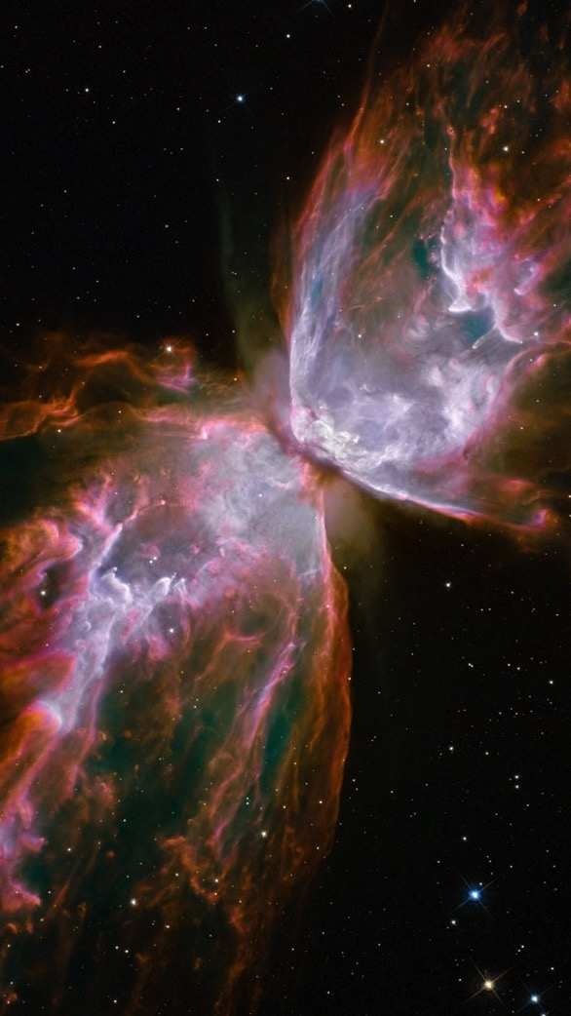
yoga
here
now
ONEness WHOLEness
interCONNECTEDness

Slide 2
all is one
yoga is oneness with mySELF
= with all that is

Slide 3
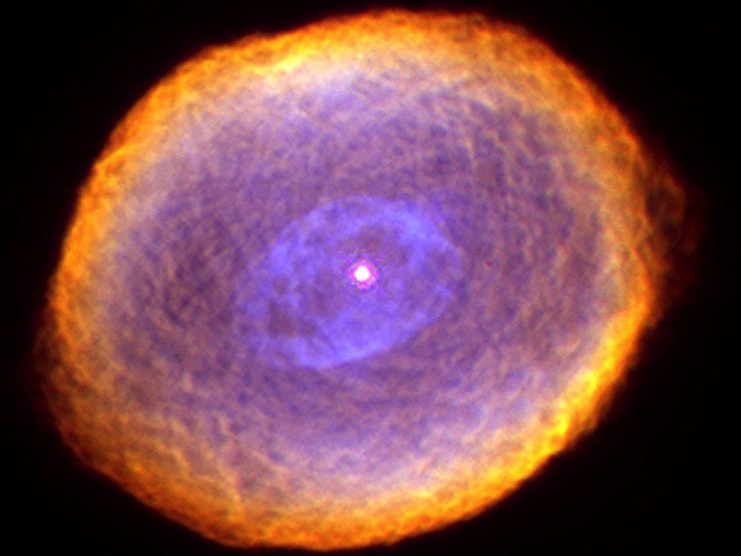
one is whole
YOGA
is experiencing the wholeness of all that is
yoga is experiencing the wholeness of all that is

Slide 4
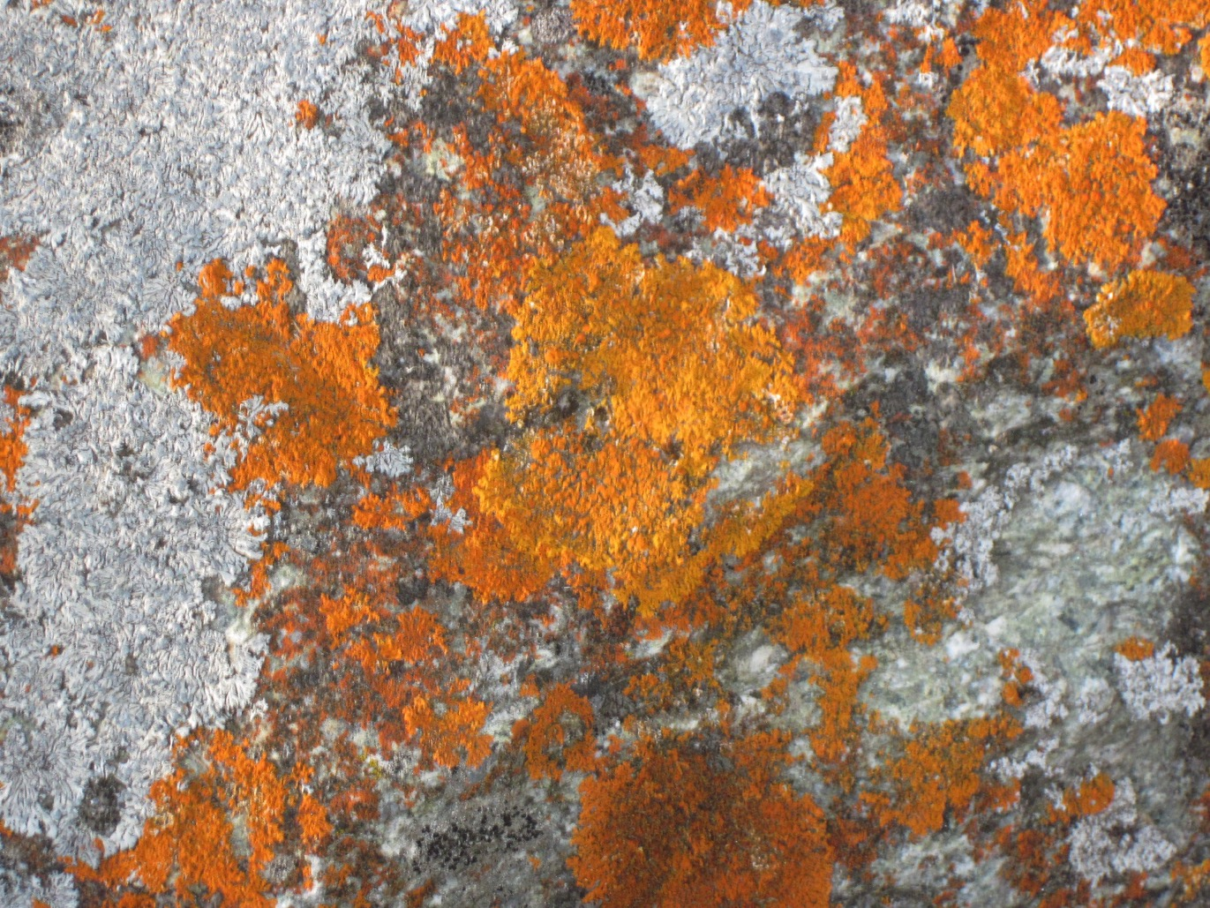
ALL IS INTER CONNECTED
yoga is interacting consciously with all that is

Slide 5
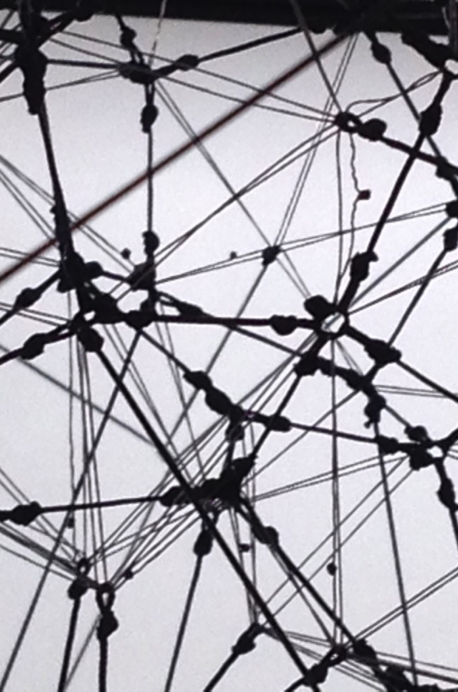
consciously or not, we behave according to our belief system
all sorts of patterns and conditionings determine our behaviour
most of them are unconscious yoga = setting ourselves free from any limiting belief and conditioning
beliefs
conditionings

Slide 6
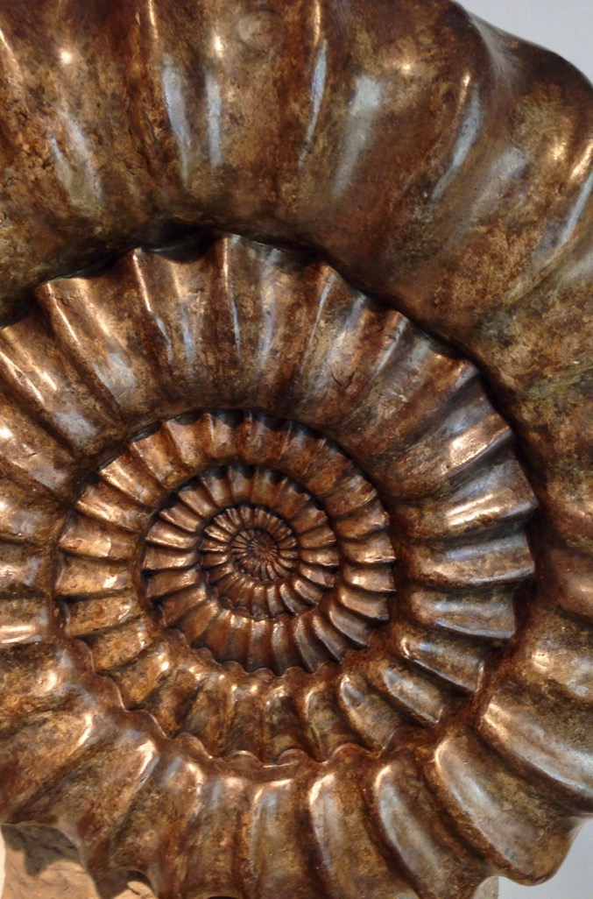
evolving consciousnesss
patterns and belief systems aren’t an issue, actually
they keep evolving with us
we can change any pattern or belief we don’t resonate with any more, provided we are aware of it and willing to change yoga = transforming or dropping what doesn’t support Self realisation

Slide 7
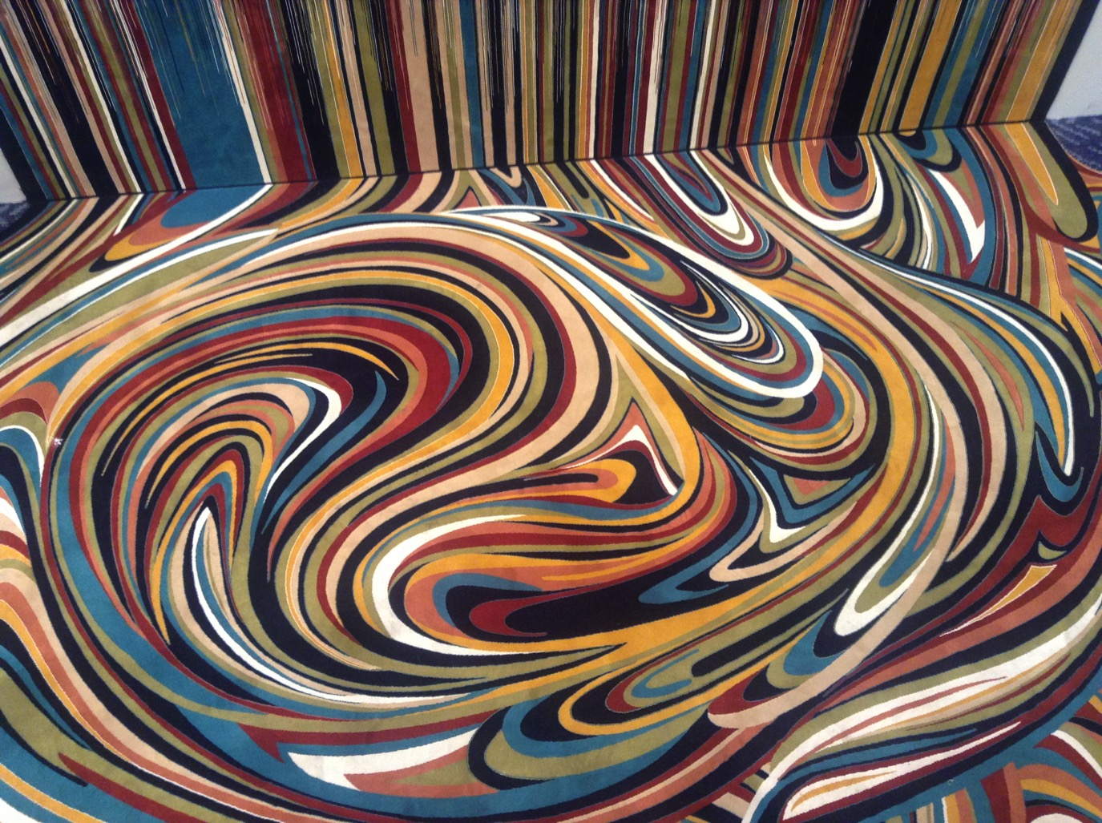
attachment
- attachment is the issue (the ego can identify with anything and stick to it)
- this prevents us from changing as we expand and expanding as we change
- we disconnect from the flow of life and get rigid (fixed patterns, rules, control)
- this always signals a fear based reaction (fight, flight, freeze)
yoga = experiencing reality as it is embracing it fully with complete detachment

Slide 8
our challenge
- the manifest world (prakrti)is a projection of
consciousness (purusha)
- our experience of the world (including the ego) is a
projection of our consciousness as well, it’s a game
- our Self manifests situations and circumstances best suited for our awakening (= reconnection with Self)
- by taking responsibility for our personal preferences (feelings, likings and dis-likings), we can refocus on the
actual challenge
yoga = ONEness with SELF ONEness with ALL WHOLEness

Slide 9
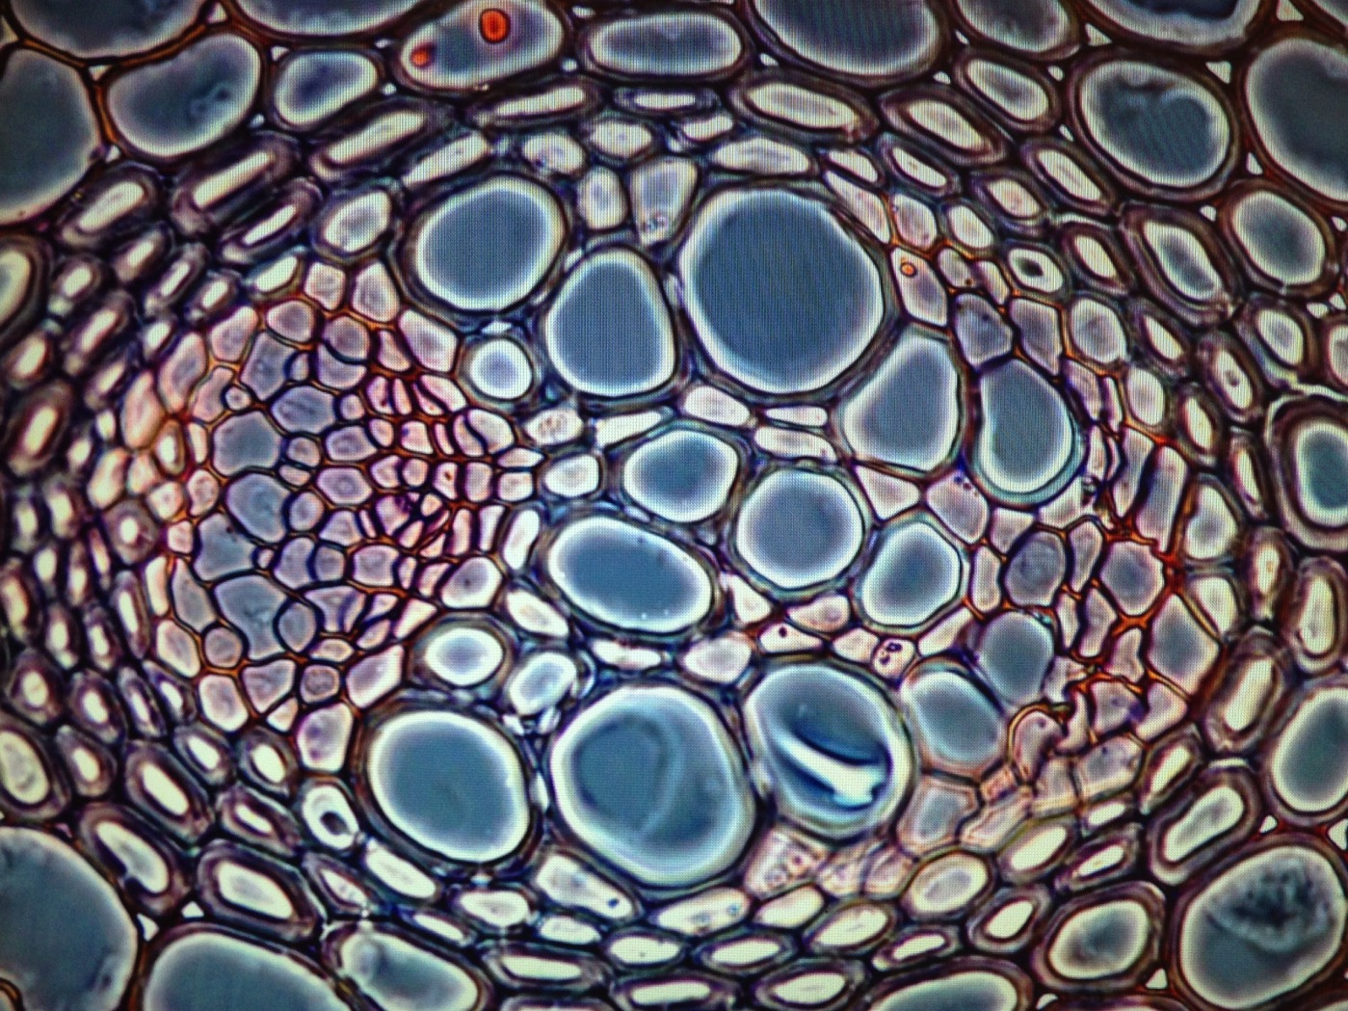
I am
We are

Slide 10
inter connected dependent
so to recap
- everything is connected with everything
- everything depends on everything
- everything impacts on everything
- the more aware we are, the more conscious our relationships with all that is can be

Slide 11
conscious connection
consciousness goes hand in hand with responsibility
we are responsible for what we share with/project into the global network (to the extend of our consciousness)
a conscious spirit-mind-heart-body impacts a lot more on common field than a confused one
mind your projections (positive as well as negative) !

Slide 12
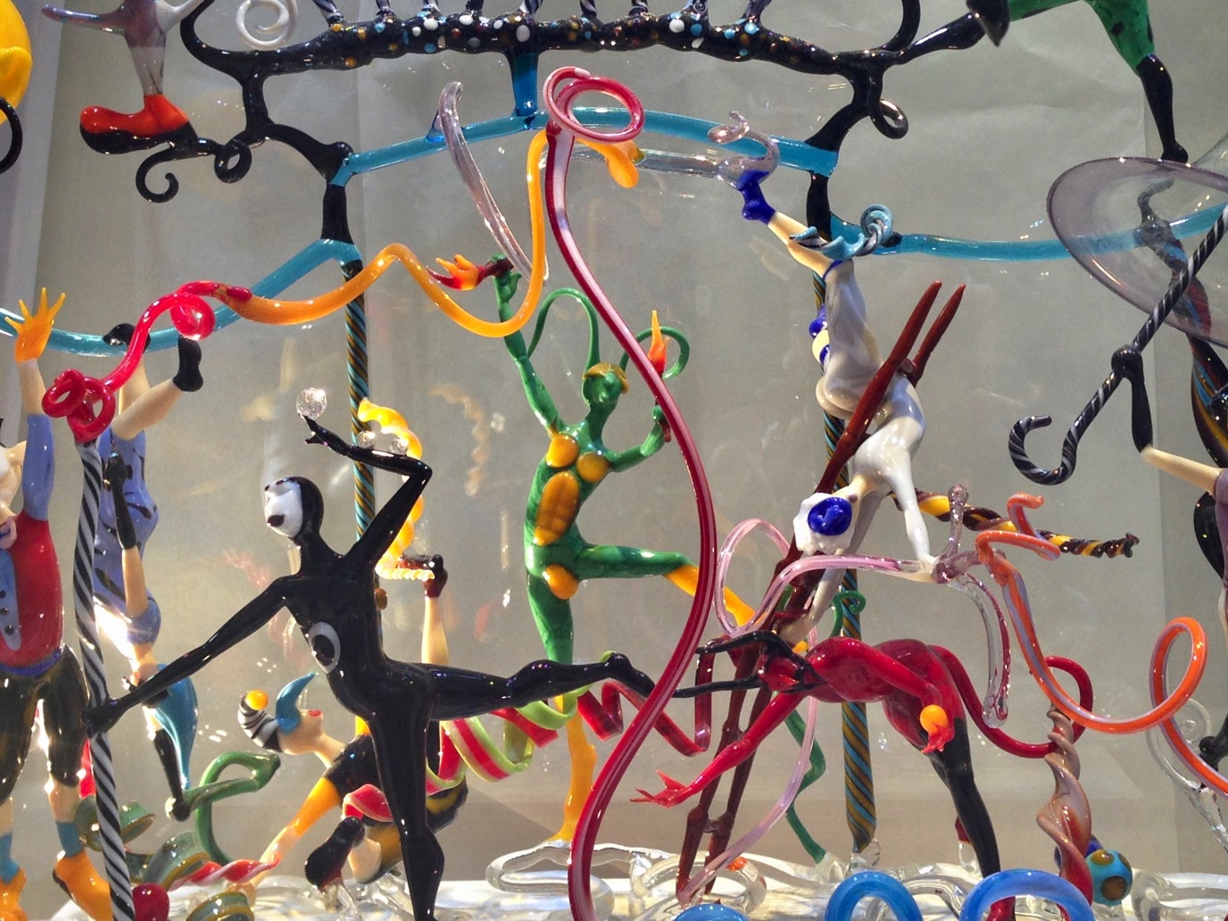
what is your uniquEness ?
this is how you can best
contribute to
ONENESS
and WHOENESS

